Slide 1
PROFESSIONAL GROOMING & ETIQUETTE

Slide 2
CONTENT
Intro – Professional Grooming as a component of Professional Behaviour.
Why does professional grooming matter..with reference to the ‘I’ Brand.
Managing your visual image- Formal dress code for men and women
Basic grooming and hygiene
Workplace Etiquette
Email Etiquette( In brief)

Slide 3
PROFESSIONAL GROOMING & ETIQUETTE
PROFESSIONAL BEHAVIOUR comprises of ‘APPROPRIATE’
Corporate Grooming
Business Etiquette
FAMOUS QUOTE...
Your personal beauty is a greater recommendation than any letter of reference.
- Aristotle

Slide 4
The ABC s of Business Etiquette that can ensure to take one a long way in building successful professional relationships :
A- APPEARANCE
B – BEHAVIOUR
C- COMMUNICATION

Slide 5
CORPORATE GROOMING
Organisations today invest heavily viz..millions of dollars in the branding and packaging of their products, as they wish to convey a strong ‘IMAGE’ of the product/brand to their customers!
In order to lure the customers who often are convinced of the features of the product , just by looking at its attractive appearance ,companies often modify the PRODUCT PACKING ....
Let us have a look at the following products....

Slide 6
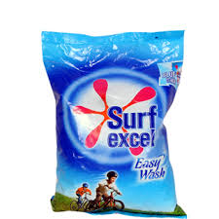
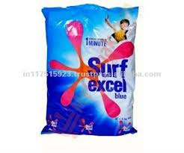
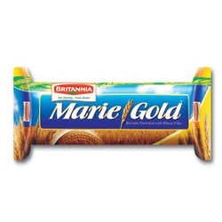
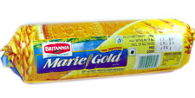
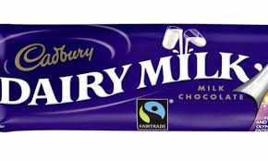
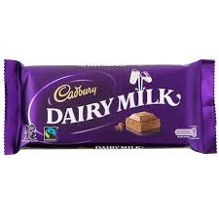

Slide 7
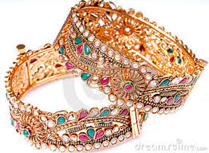
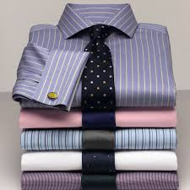
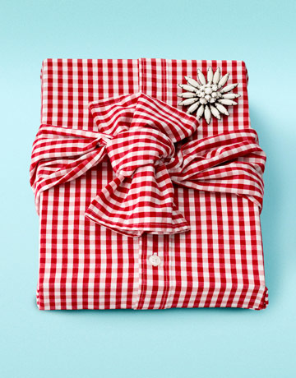
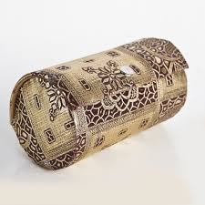
How would you like your gifts to reach you..?
Or

Slide 8
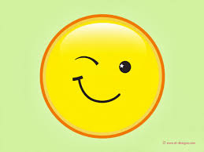
WELL....... GOOD PACKING DOES MAKE A HUGE DIFFERENCE TO THE LOOK OF THE PRODUCT... DOESN’T IT ...?

Slide 9
What about the ‘IMAGE OF AN EMPLOYEE’ then ???
Does the external appearance of an individual really matter ...Especially when we have all often heard over the years,
“DO NOT JUDGE A BOOK BY ITS COVER..........”.

Slide 10
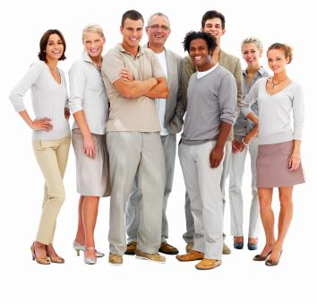

Slide 12
Studies have revealed that physical/external presentation of an individual does matter & people intuitively equate beauty with concepts like better/smart /confident or even successful !!
In today’s world where quick decisions and fast judgements are made....... the ‘FIRST IMPRESSION’ does matter.. atleast at the initial level !
So....lets accept the fact– fortunately/unfortunately..
‘PEOPLE ARE OFTEN JUDGED BY THEIR EXTERNAL APPEARANCE’!

Slide 13
ETIQUETTE
It is said that the word ‘ETIQUETTE’ originated from the French word ‘Une Euitte’ which meant a ticket/placard given to the visitors to the court of King Louis XIV , which contained the list of rules of behaviour for every situation in the court.
This also contained the clothes one would wear for an event, the manner of greeting one another , etc

Slide 14
In other words, “Etiquette” indicates the PROTOCOL of behaviour one presents while interacting with the others in a social or professional group.”
When they are displayed at social functions, can be referred to as social etiquette, while in business environment , they form ‘BUSINESS ETIQUETTE’.
ACTIVITY1 :
Close your eyes & think of one personality that comes to your mind and you admire the most as the most well groomed person you have met so far.. what is it you have liked about him/her the most. ( DISCUSS)

Slide 15
VISUALIZE & SAY...
How would you expect to see the following people in their professions....
A DOCTOR
A LAWYER
A TEACHER
A BUSINESSMAN
...WHY ??

Slide 16
A DOCTOR

Slide 17
A LAWYER

Slide 18
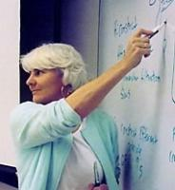
A TEACHER

Slide 19
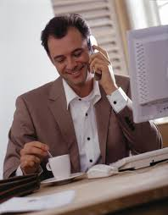
A BUSINESSMAN

Slide 20
The ‘I’ Brand –
The power of ‘VISUAL’ on human mind is quite ‘HIGH’ .. And so its strength in communicating the message !
Consider yourself as a ‘Brand’ and imagine/visualise the impact of your clothing on your colleagues/clients, etc..
ASK YOURSELF –
Is my Image in tune with my profession ?
Am I as a Brand reflecting the company’s true image ?
How much would I score on my personal branding ?

Slide 21
A self analysis questionnaire ..... HANDOUT !

